Slide 1
Assessment Of Urban Heat Island Using Remotely Sensed Imagery & GIS Technology Of Ernakulam District
Submitted by
DILFA CP
M1 GI
ROLL NO:39

Slide 2
INTRODUCTION
Metropolitan area that is significantly warmer than its surrounding rural areas due to human activities and the built environment. The main contributors to the urban heat island effect include Human activities, Impervious surfaces, Lack of vegetation, Building materials etc.
Ernakulam as witnessed substantial urban development in recent years, accompanied by changes in land use and the built environment. This study seeks to undertake a comprehensive assessment of the Urban Heat Island effect in Ernakulam District by leveraging advanced technologies such as Remotely Sensed Imagery and Geographic Information System (GIS).

Slide 3
SUMMARY OF LITERATURE REVIEW
SL No | Title of journal | Year | Inference
1 | The influence of land use on the urban heat island in Singapore | 2007 | In this study he use both qualitative and quantitative methodologies to analyse the data. The results show that the land usage will influence urban temperature. In the daytime, the order of surface temperature in different land use types is industrial, commercial, airport, residential, and park respectively. However, during the night time, the order is commercial, residential, park, industrial, and airport.
2 | Analysis of urban heat island characteristics and mitigation strategies for eight arid and semi‑arid gulf region cities | 2021 | The study indicated that barren areas had the highest mean LST values In comparison to urban and green regions. The findings indicate that there is a temperature differential of between 1 and 2 °C between bare areas and urban areas, between 1 and 7 °C between bare areas and green areas, and between 1 and 5 °C between urban areas and green areas. Moreover, the LST values differed for every LULC category,

Slide 4
SL NO | Title of journal | Year | Inference
3 | Mapping of Micro-Urban Heat Islands and Land Cover Changes: A Case in Chennai City, India | 2009 | This research aims to analyse the differences in the city's thermal environment caused by various circumstances of land cover. Using TM and ETM+ data from 1991 and 2000, this study examines the variations in temperature inside Chennai and examines the association between land cover types and surface temperature
4 | Effects of pavement texture and colour on Urban Heat Islands | 2021 | In this study he showed that during peak hours, within each texture, Red and Grey coloured pavers displayed surface temperatures up to 4.2 ◦C and 4.5 ◦C lower, respectively, in comparison to Black pavers. . Red Jagged had the lowest recorded surface temperature, at 42.9 ◦C, which is 0.6 ◦C lower than Grey Smooth. Overall, it can be said that the red-colored jagged paver can reduce the pavement's contribution to the UHI effect when taking into account both the colour of the paver and the concrete's roughness.

Slide 5
OBJECTIVE
To study the temperature distribution across the different land use types
To investigate the influence of various land use types on the urban heat island
Analyze Urban Heat Island (UHI) intensity and spatial distribution

Slide 6
Details
Data | Date of Acquisition | Source
Landsat 8 | 31/08/2023 | USGS

Slide 7
DATA
Acquisition of satellite image
(LANDSAT 8)
Topographical map of kerala
Conversion to Top of Atmosphere (TOA) Radiance
Conversion to Top of Atmosphere Brightness Temperature (BT)
NDVI
Calculation of Land Surface Emissivity- E
Calculation of LST
Preparation of Ernakulam district shape fie
Calculation of UHI and UHI (stack) Profile

Slide 8
METHODOLOGY
Landsat-8 images collected from US Geological Survey (USGS) on the Date of 31/08/2023, The image with 18% cloud coverage.
The Steps are,
1. Conversion to Top of Atmosphere (TOA) Radiance:
Lλ = ML * Qcal + AL-Oi
2. Conversion to Top of Atmosphere Brightness Temperature (BT)
BT = K2 / In (k1 / Lλ + 1) - 273.15
3. Normalized Difference Vegetation Index (NDVI):
NDVI = (Band 5-Band 4)/ (Band 5+Band 4)

Slide 9
4. Land Surface Emissivity (LSE):
PV = ((NDVI – NDVI min) / (NDVI max – NDVI min))2
PV-Proportion of Vegetation
E = 0.004 * PV + 0.986
5. Land Surface Temperature (LST):
LST = BT/ (1 + (λ * BT / c2) * ln(E))
6. Urban Heat Island (UHI) and UHI (stack) Profile
𝑈𝐻𝐼=𝐿𝑆𝑇−𝐿𝑆𝑇𝑚𝑆𝐷

Slide 10
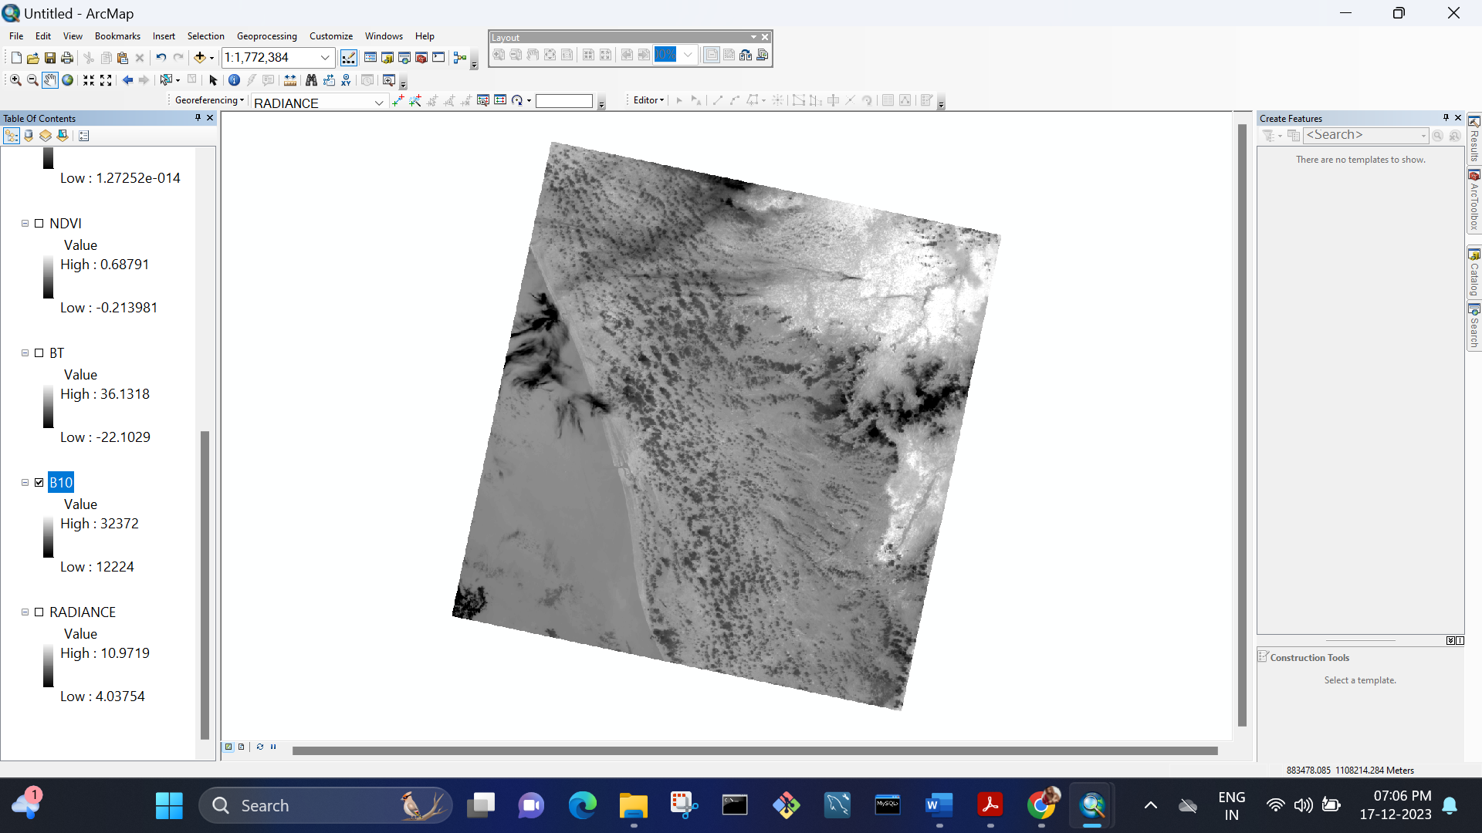
Landsat 8 Band 10
WORK DONE

Slide 11
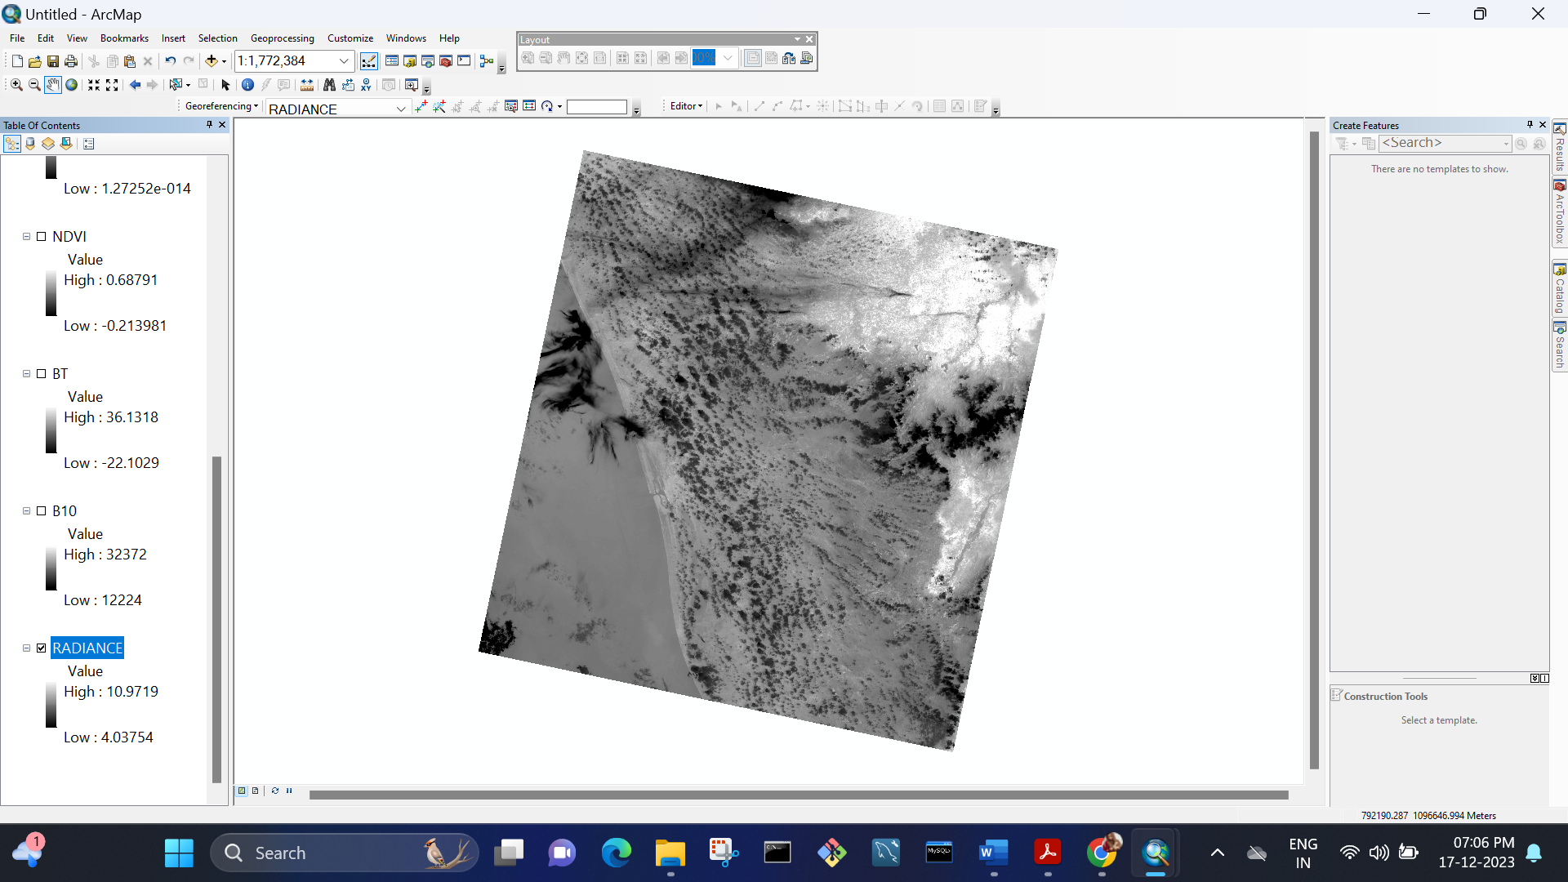
Conversion to Top of Atmosphere (TOA) Radiance

Slide 12
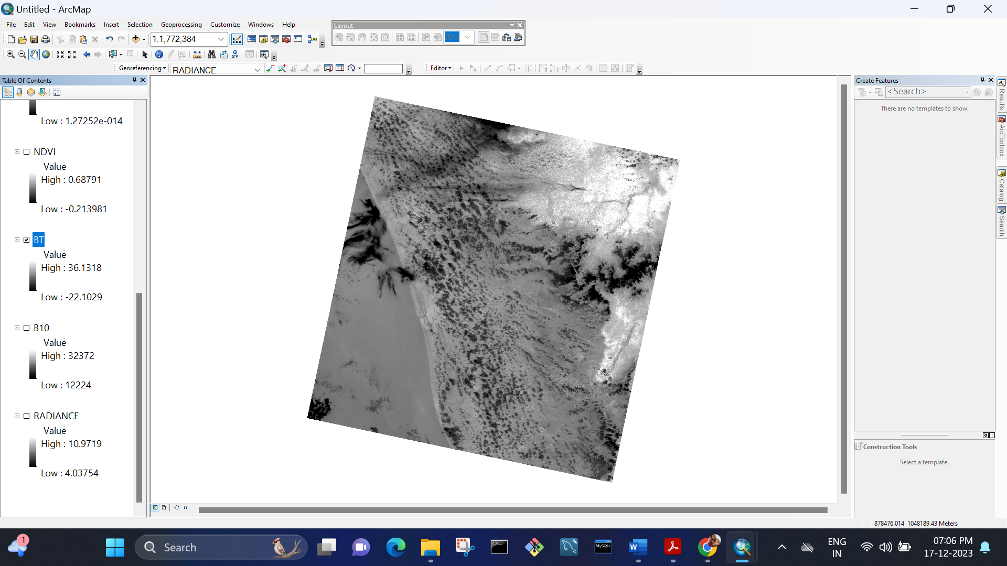
Conversion to Top of Atmosphere Brightness Temperature (BT)

Slide 13
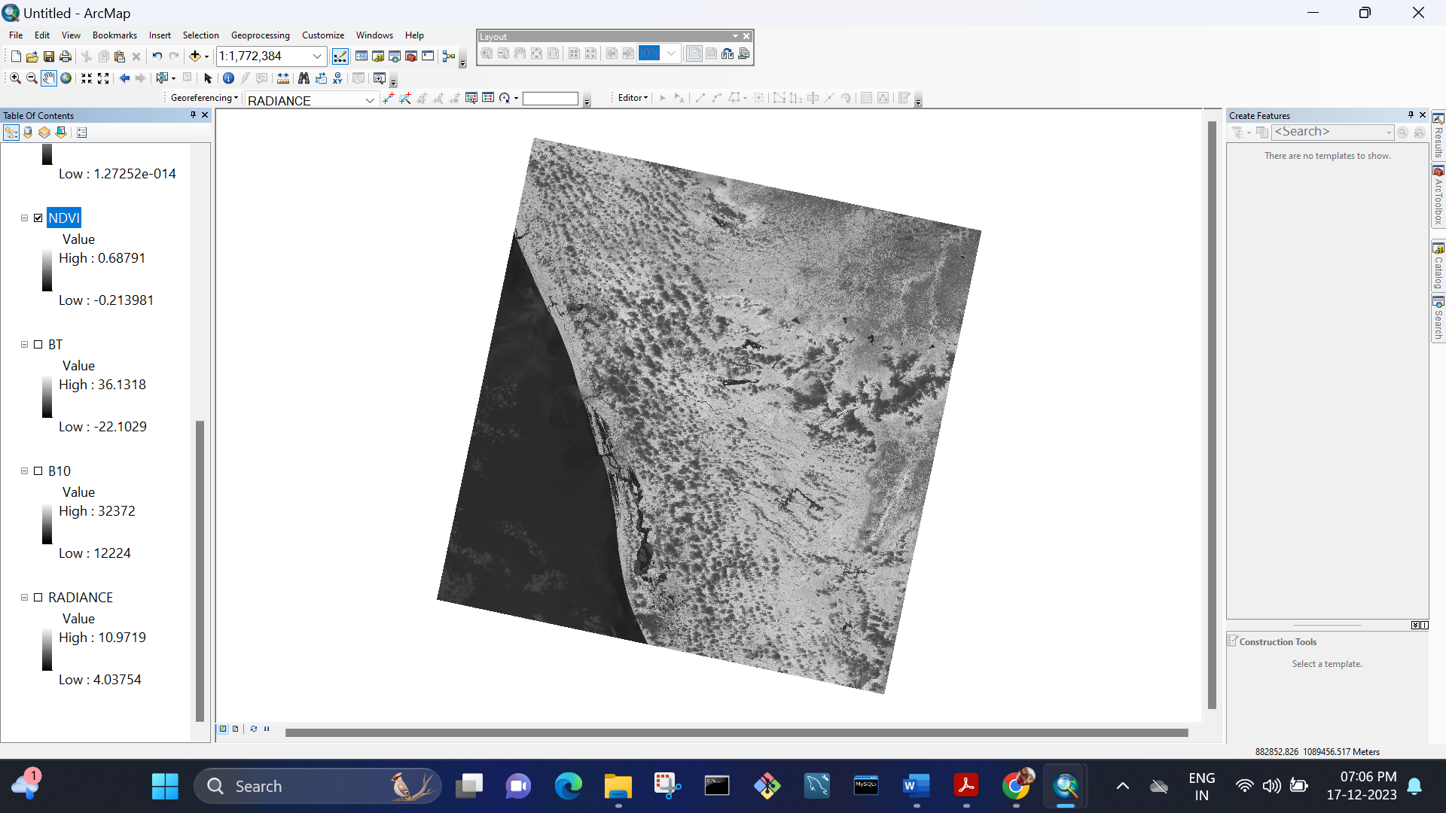
NDVI

Slide 14
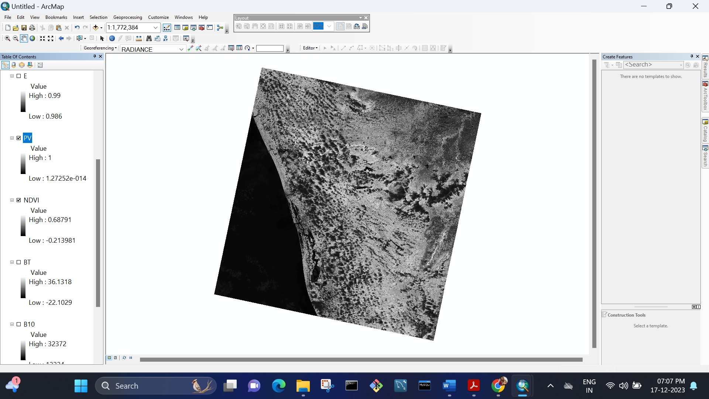
PV-Proportion of Vegetation

Slide 15

Land Surface Emissivity

Slide 16
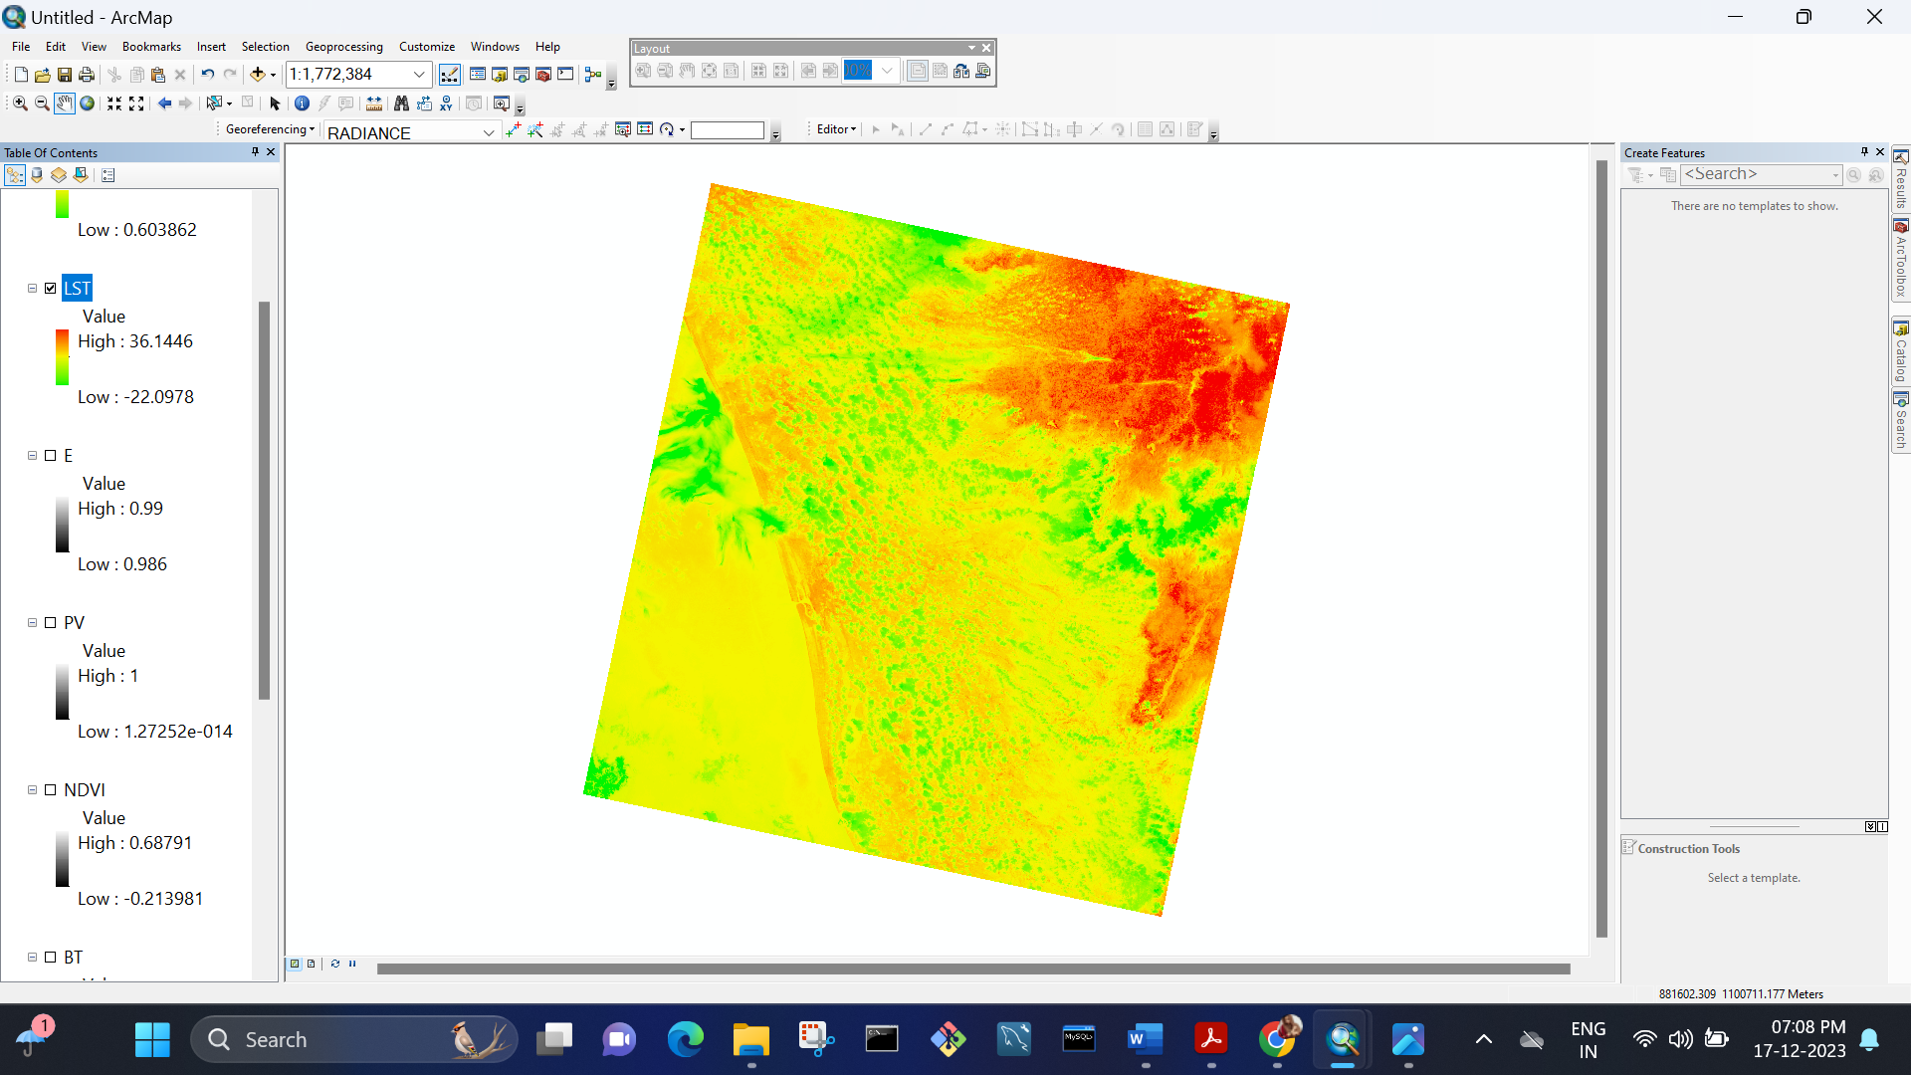
LST

Slide 17
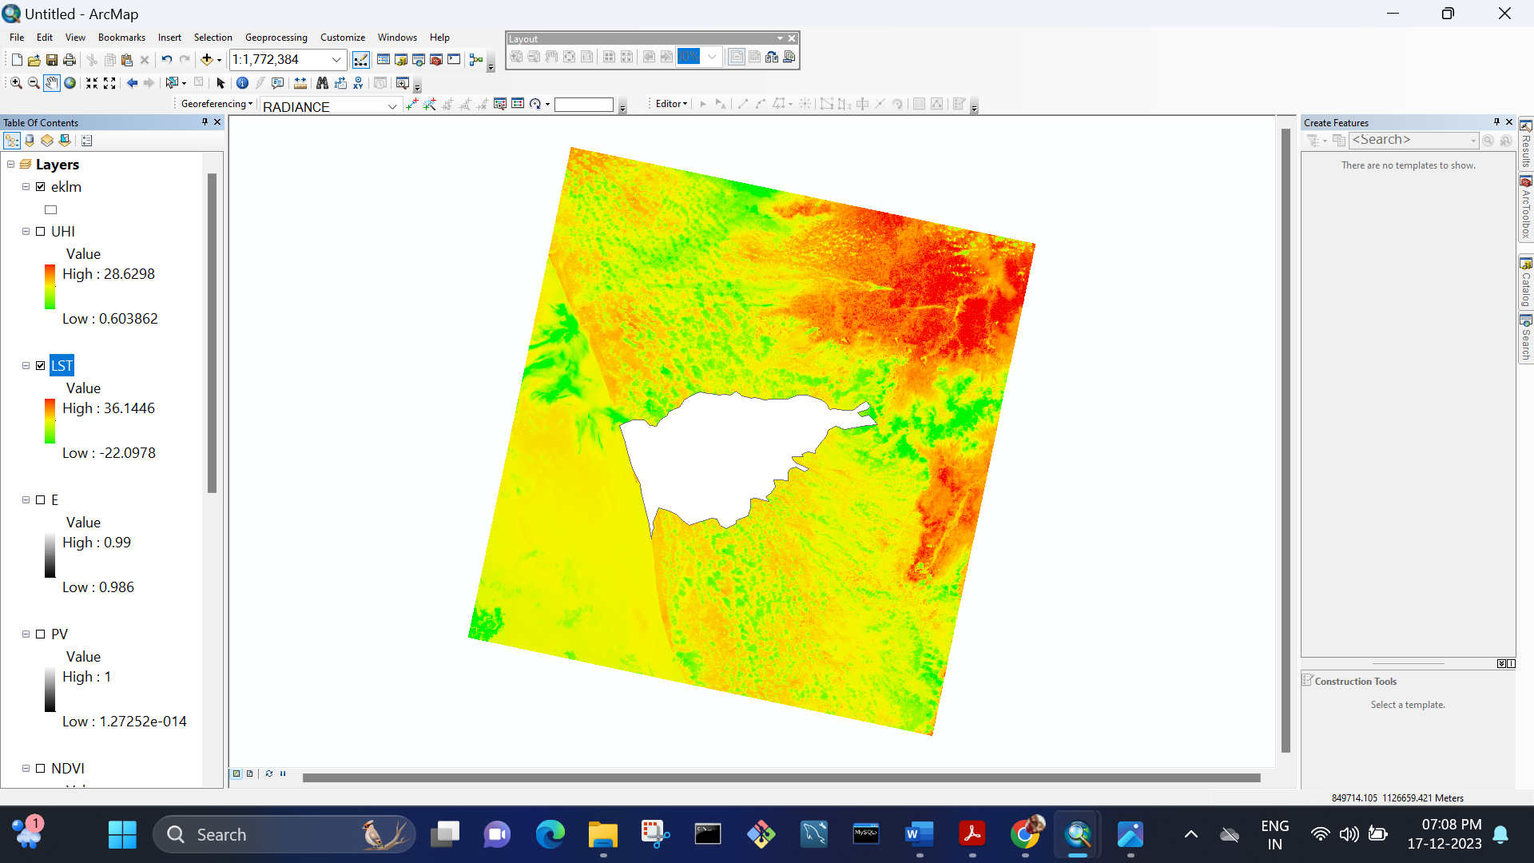

Slide 18
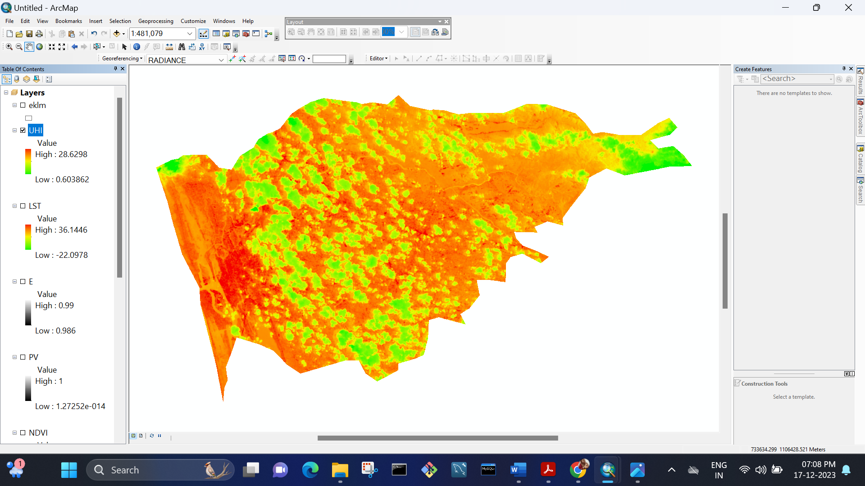
UHI

Slide 19
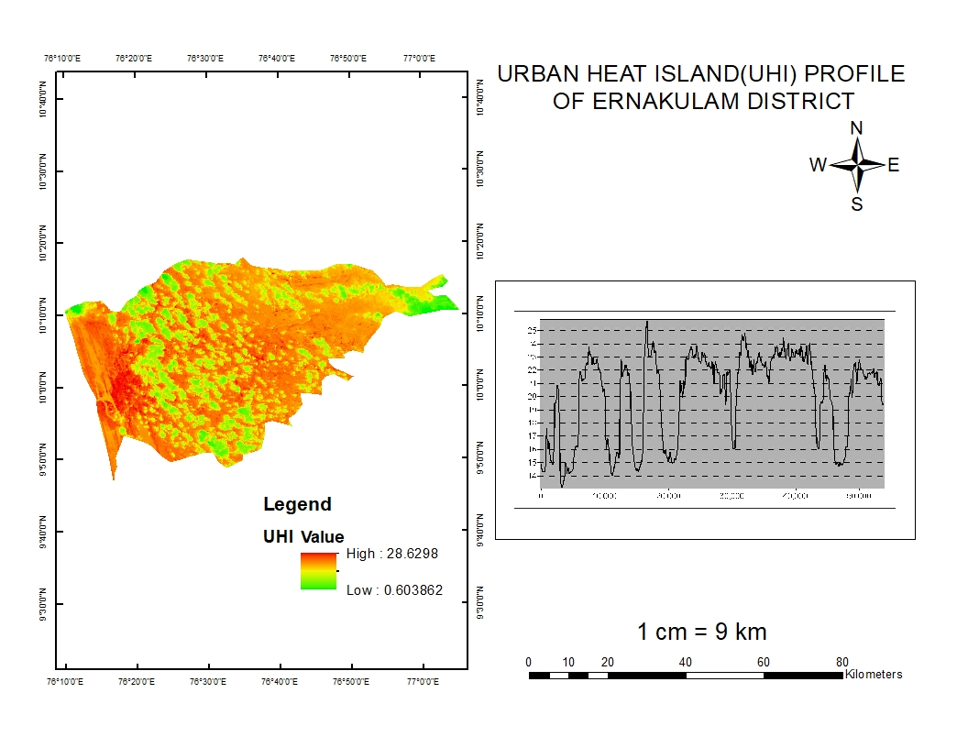
RESULT

Slide 20
CONCLUSION
The Assessment of urban heat island (UHI) in Ernakulam district, employing remotely sensed imagery and GIS technology, unveils distinctive spatial patterns of temperature variations. This study shows the spatial temperature distribution across the different land use types. The mean temperature of Ernakulam in 31/08/2023 is 21degree.

Slide 21
REFERENCE
Senevirathne, D.M., Jayasooriya, V.M., Dassanayake, S.M. and Muthukumaran, S. (2021). Effects of pavement texture and colour on Urban Heat Islands: An experimental study in tropical climate. Urban Climate, 40, p.101024.
Amirtham, L.R., Devadas, M.D. and Perumal, M. (2009). Mapping of Micro-Urban Heat Islands and Land Cover Changes: A Case in Chennai City, India. The International Journal of Climate Change: Impacts and Responses, 1(2), pp.71–84.
Yang, L., Qian, F., Song, D.-X. and Zheng, K.-J. (2016). Research on Urban Heat-Island Effect. Procedia Engineering, [online] 169(169), pp.11–18.
Almeida, C.R. de, Teodoro, A.C. and Gonçalves, A. (2021). Study of the Urban Heat Island (UHI) Using Remote Sensing Data/Techniques: A Systematic Review. Environments, 8(10), p.105.
Lokoshchenko, M.A. (2014). Urban ‘heat island’ in Moscow. Urban Climate, 10, pp.550–562..
Abulibdeh, A. (2021). Analysis of urban heat island characteristics and mitigation strategies for eight arid and semi-arid gulf region cities. Environmental Earth Sciences, 80(7).

Slide 22
Hsu, A., Sheriff, G., Chakraborty, T. and Manya, D. (2021). Disproportionate exposure to urban heat island intensity across major US cities. Nature Communications, [online] 12(1), p.2721.
Gobakis, K., Kolokotsa, D., Synnefa, A., Saliari, M., Giannopoulou, K. and Santamouris, M. (2011). Development of a model for urban heat island prediction using neural network techniques. Sustainable Cities and Society, 1(2), pp.104–115.
Hong, J.-W., Hong, J., Kwon, E.E. and Yoon, D.K. (2019). Temporal dynamics of urban heat island correlated with the socio-economic development over the past half-century in Seoul, Korea. Environmental Pollution, 254, p.112934.
Kardinal Jusuf, S., Wong, N.H., Hagen, E., Anggoro, R. and Hong, Y. (2007). The influence of land use on the urban heat island in Singapore. Habitat International, 31(2), pp.232–242.

